Slide 1

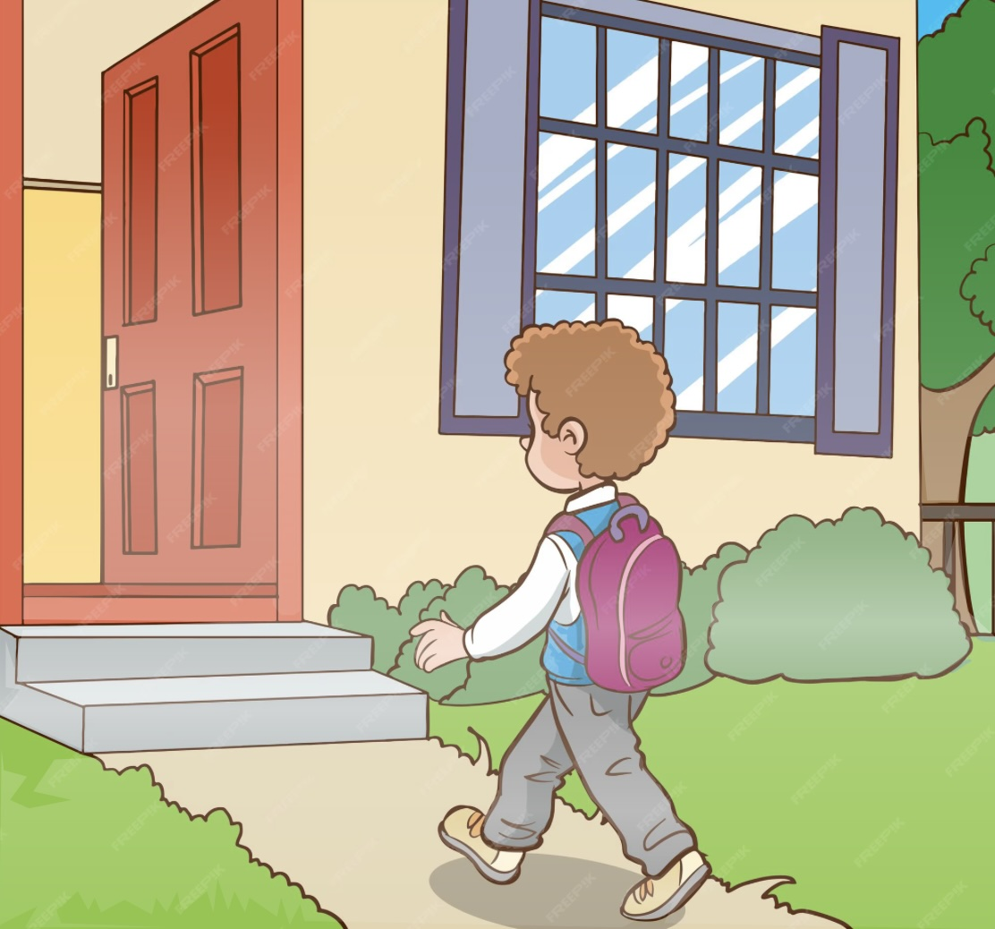







Slide 2
7:00
8:00
6:20
4:30
6:00
7:30
9:00
10:40

